Slide 1
WELCOME TO INDIAN FESTIVALS
PRSENTED BY
RAM BHUMBAR

Slide 2
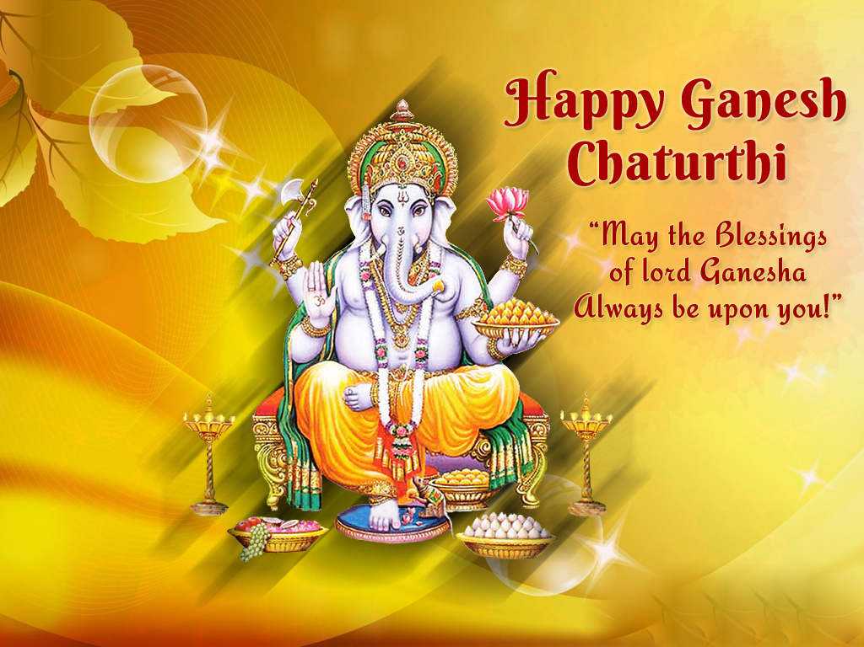

Slide 3
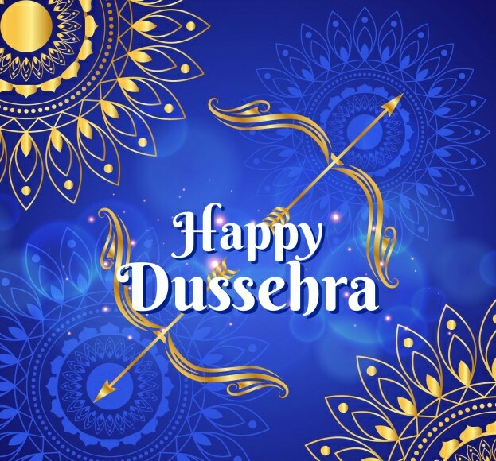

Slide 4
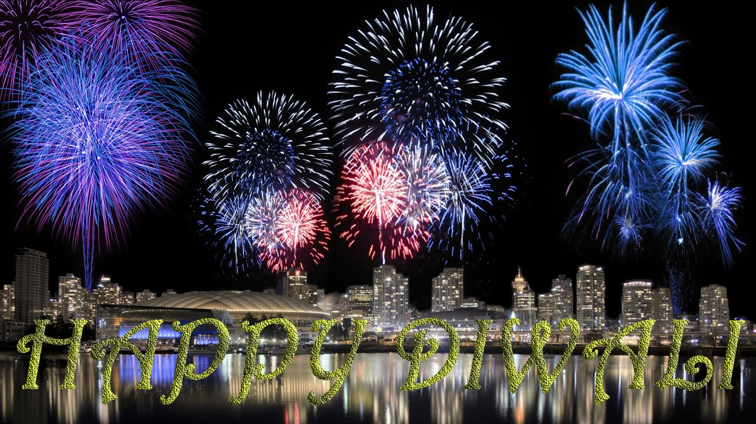

Slide 5
